Slide 1




Training Activities for Cal/OSHA Top 10 Violations
Isabel Bravo, PHR, ASP

Slide 2

Volunteers Needed
Notes:
Before the session starts, we need to recruit some people to volunteer to participate in our activities so I like to make it a point to thank them in advance in the beginning and also gets others ready to volunteer with them when we ask people to form teams.

Slide 3
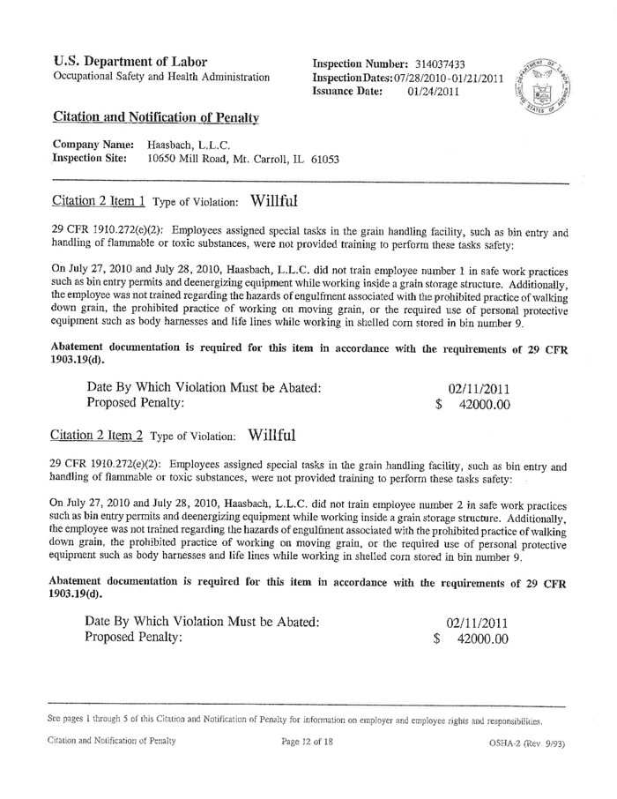
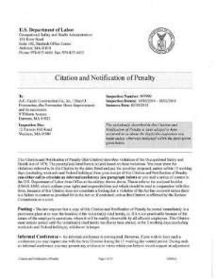

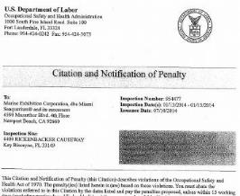
The Top 10 Citations are…......
Notes:
Every year OSHA published the ten more frequently cited standards in a list called OSHA’s Top Ten. Ask the group to shout out their guesses for what these top ten are.

Slide 4
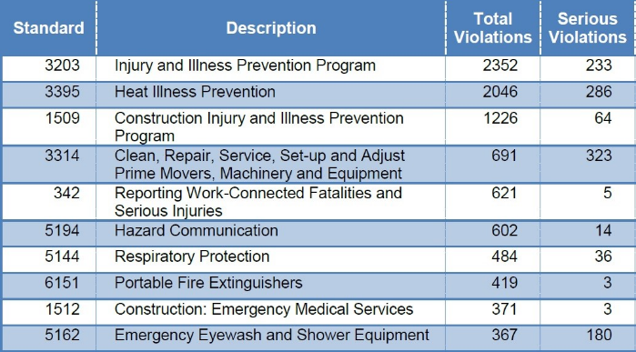
Cal/OSHA Top 10 Violations for 2017
Notes:
Cal OSHA Reporter –May 11, 2018 Vol 45 No 18
00-12079
Review this official list of OSHAs top ten and see how many the audience was able to correctly guess.

Slide 5
Training Activities for the Top 10
IIPP | 8 Elements of IIPP
Heat Illness Prevention | Symptoms Game
Construction-IIPP | Discussion
LOTO | Post-It Notes
Reporting Serious Injuries | Brainstorming
Hazard Communication | Pictogram
Respiratory Protection | Respiratory BINGO
Portable Fire Extinguishers | Fire Extinguisher Game
Construction EMS | A-Z Race
Emergency Eyewash/Shower | Picture of Unit

Slide 6
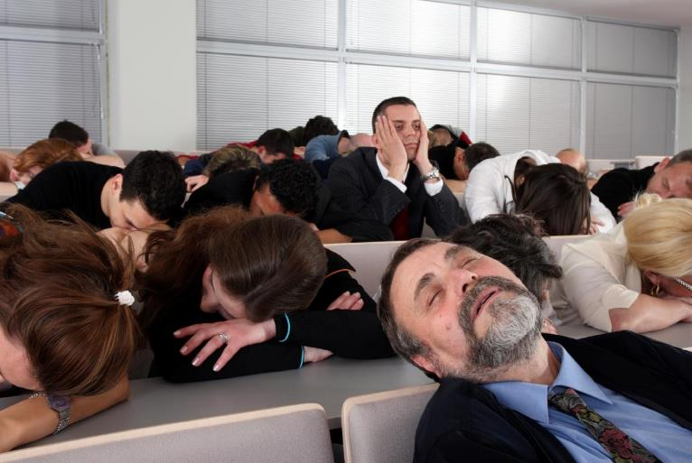
Notes:
Have you ever had a training class that looked like this?

Slide 7
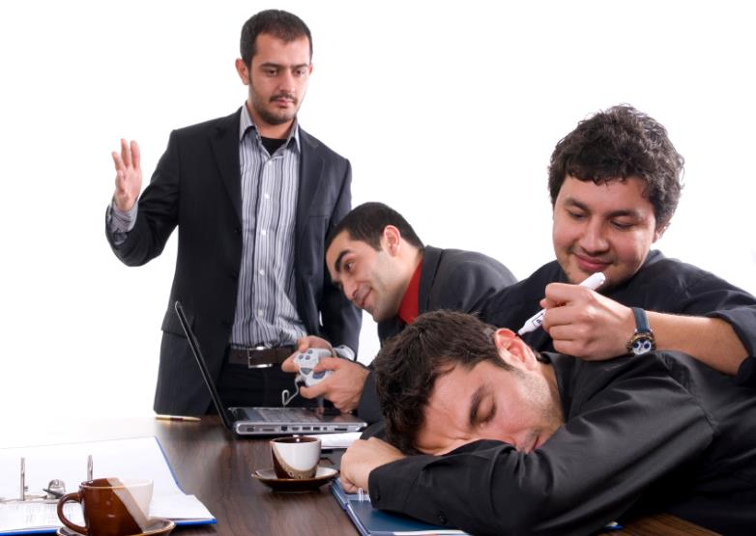
Notes:
Or a class where trainees were not paying attention?

Slide 8
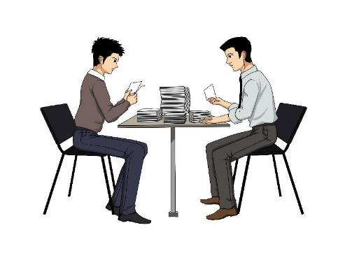
Accelerated Learning Apply to Safety
Activity based
Learning from peers
Self-directed
Fun
Notes:
One way to keep your training classes interesting is by making them interactive and buy following the principles of accelerated learning.
The key points of accelerated learning are:
- activity based
Learning from peers
Self-directed
Fun

Slide 9

Notes:
In one of the first training classes where I tried to incorporate activities based on accelerated learning methods, I was in a chemical manufacturing facilities in Kearny, NJ and if you are from NY or NJ you know this area can be a little rough. This is seriously what the attendees looked like. I was a little nervous about trying out some of the activities with this group but the class went great and they loved it. One guy said he really appreciated not having to sit in a boring class and be bored for two days straight.

Slide 10

IIPP (3203)
Notes:
Elements of an IIPP
Assignment of Authority and Responsibility: Identify the person or persons with the authority and responsibility for implementing the program
Compliance: Include a system for Compliance
Communication
Hazard Assessment: Include procedures for Identifying Hazard
a When program established
b New substance, processes, procedures or equipment are introduce
c Aware of new or previously unrecognized hazards
Investigations
Hazard Abatement: Correction of unsafe or unhealthy conditions
Training and Instruction
Documentation

Slide 11

IIPP Elements Sheet

Slide 12
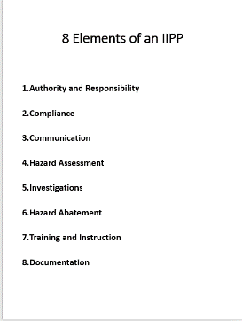
Answers

Slide 13
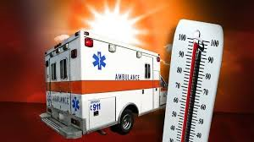
Heat Illness Prevention (3395)

Slide 14
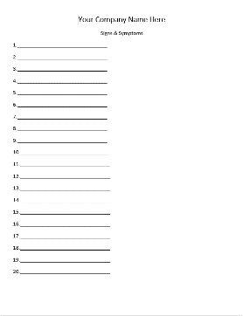
Symptoms Game

Slide 15
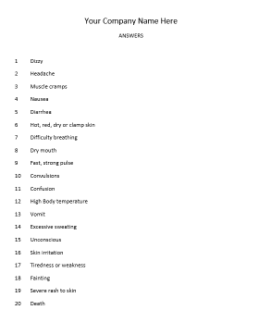
Answers

Slide 16

Activity based
Learning from peers
Self-directed
Fun
Notes:
Remember the principles of accelerated learning.
- activity based
- learning from peers (teammates)
- self-directed
Fun
Do you see how the fall protection pack follows all of these principles?

Slide 17

Construction Injury and Illness Prevention Program (1509)
Notes:
The 5 Elements Are:
Every employer shall established, implement and maintain an IIPP under 3203
Every employer shall have a written code of safe practices
The code of safe practices shall be posted
Periodic supervisor meetings shall be held
Supervisor employees shall conduct tailgate (Toolbox0 meetings every 10 days

Slide 18
Construction IIPP Elements
Every employer shall established, implement and maintain an IIPP under 3203
Every employer shall have a written code of safe practices
The code of safe practices shall be posted
Periodic supervisor meetings shall be held
Supervisor employees shall conduct tailgate (Toolbox0 meetings every 10 days

Slide 19
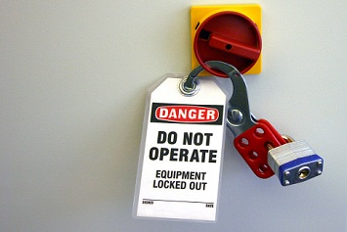
Lockout/Tagout (3314)

Slide 20

LOTO Steps
Inspect Machine and Identify Sources of Power
Clean Up Work Area
Notify Workers in Area
Turn Off Power
Verify that Power is Off
Remove the Lock and Tag
Apply Lock and Tag
Turn Power On
Notify Others That Work is Complete
Turn off Power
Notes:
Lock Out Tag Out Layers is a type of activity that is good for any type of workplace procedure that involves steps and it is very inexpensive and simple to use. First, you need to identify the steps of a lock out/tag out procedure in your facility and write these steps out separately on post-it notes. For each tam in your training class, write out one set of post-its. (If you have a lot of teams and want this to go faster you can just make up a sheet of labels in Word with each step as a different label and make multiple copies).
Tell each team that they are not to look at the steps until you say go. When you do, they should work as quickly as possible to stick the post-its on the wall (or desk) in the correct order before the other teams do.
When a team has said they are finished, review their answers with the rest of the class to ensure they are right (this also gives you another chance to review the information).

Slide 21
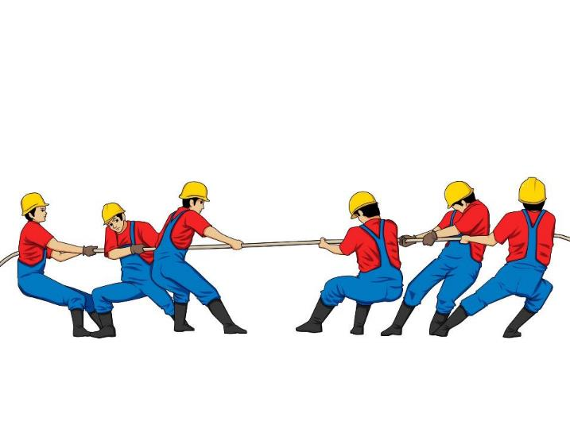
Team Work
Notes:
Team Work - or learning from our peers – is a key principle of accelerated learning. Trainees learn better when they learn from each other. The activities in this presentation all work best when the activity is done on teams.
What is the best team size? (take guesses from the audience)
Research says the best size is 4-7. If a team is too small, once person can easily dominate the group and if it is too large, it becomes too easy to hide and not participate. In some cases your class size might be too small to have several teams of 4-7 so just do the best you can and have at least two or three people work together.

Slide 22

What do you have?
Notes:
After a few minutes, ask the class – What do you have?

Slide 23

The right order is…

Slide 24

1
2
3
4
5
Inspect Machine and Identify Sources of Power
Verify That Power is Off
Notify Workers in Area
Turn Off Power
Apply Lock and Tag
6
7
8
9
10
Notify Others That Work is Complete
Work on Equipment
Clean Up Work Area
Remove Lock and Tag
Turn Power On
Notes:
While each facility may have a slightly different order, the steps are basically the same. To use this in your facility, you should list the correct order that those working on your plants are expected to use. If you can make it even more specific, such as including the actual location where the tags can be found and/or where to take the completed tags once the job is complete, that would be even more effective.

Slide 25

Notes:
A word about competition – some of these activities, such as scaffolding sort, can involve a good dose of competition. Competition can be a great thing in safety training but beware if you have a trainee or two in our class that is too competitive where it becomes threatening to others. If so, you may have to dial back the level of competitiveness in your class.

Slide 26
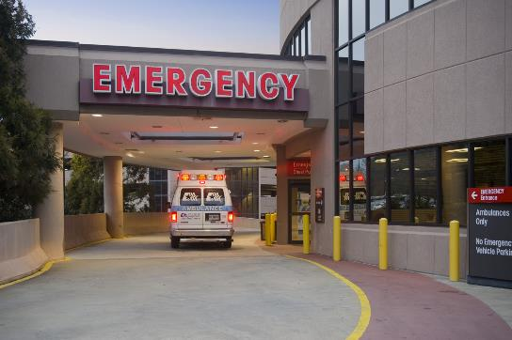
Reporting Work-Connected Fatalities and Serious Injury (342)
Notes:
§342. Reporting Work-Connected Fatalities and Serious Injuries.
(a) Every employer shall report immediately by telephone or telegraph to the nearest District Office of the Division of Occupational Safety and Health any serious injury or illness, or death, of an employee occurring in a place of employment or in connection with any employment.
Immediately means as soon as practically possible but not longer than 8 hours after the employer knows or with diligent inquiry would have known of the death or serious injury or illness. If the employer can demonstrate that exigent circumstances exist, the time frame for the report may be made no longer than 24 hours after the incident.
Serious injury or illness is defined in section 330(h), Title 8, California Administrative Code.
(b) Whenever a state, county, or local fire or police agency is called to an accident involving an employee covered by this part in which a serious injury, or illness, or death occurs, the nearest office of the Division of Occupational Safety and Health shall be notified by telephone immediately by the responding agency.
(c) When making such report, whether by telephone or telegraph, the reporting party shall include the following information, if available:
(1) Time and date of accident.
(2) Employer's name, address and telephone number.
(3) Name and job title, or badge number of person reporting the accident.
(4) Address of site of accident or event.
(5) Name of person to contact at site of accident.
(6) Name and address of injured employee(s).
(7) Nature of injury.
(8) Location where injured employee(s) was (were) moved to.
(9) List and identity of other law enforcement agencies present at the site of accident.
(10) Description of accident and whether the accident scene or instrumentality has been altered.
(d) The reporting in (a) and (b) above, is in addition to any other reports required by law and may be made by any person authorized by the employers, state, county, or local agencies to make such reports.
"Serious injury or illness" means any injury or illness occurring in a place of employment or in connection with any employment which requires inpatient hospitalization for a period in excess of 24 hours for other than medical observation or in which an employee suffers a loss of any member of the body or suffers any serious degree of permanent disfigurement, but does not include any injury or illness or death caused by the commission of a Penal Code violation, except the violation of Section 385 of the Penal Code, or an accident on a public street or highway.

Slide 27

Brainstorm Game
Notes:
§342. Reporting Work-Connected Fatalities and Serious Injuries.
(a) Every employer shall report immediately by telephone or telegraph to the nearest District Office of the Division of Occupational Safety and Health any serious injury or illness, or death, of an employee occurring in a place of employment or in connection with any employment.
Immediately means as soon as practically possible but not longer than 8 hours after the employer knows or with diligent inquiry would have known of the death or serious injury or illness. If the employer can demonstrate that exigent circumstances exist, the time frame for the report may be made no longer than 24 hours after the incident.
Serious injury or illness is defined in section 330(h), Title 8, California Administrative Code.
(b) Whenever a state, county, or local fire or police agency is called to an accident involving an employee covered by this part in which a serious injury, or illness, or death occurs, the nearest office of the Division of Occupational Safety and Health shall be notified by telephone immediately by the responding agency.
(c) When making such report, whether by telephone or telegraph, the reporting party shall include the following information, if available:
(1) Time and date of accident.
(2) Employer's name, address and telephone number.
(3) Name and job title, or badge number of person reporting the accident.
(4) Address of site of accident or event.
(5) Name of person to contact at site of accident.
(6) Name and address of injured employee(s).
(7) Nature of injury.
(8) Location where injured employee(s) was (were) moved to.
(9) List and identity of other law enforcement agencies present at the site of accident.
(10) Description of accident and whether the accident scene or instrumentality has been altered.
(d) The reporting in (a) and (b) above, is in addition to any other reports required by law and may be made by any person authorized by the employers, state, county, or local agencies to make such reports.
"Serious injury or illness" means any injury or illness occurring in a place of employment or in connection with any employment which requires inpatient hospitalization for a period in excess of 24 hours for other than medical observation or in which an employee suffers a loss of any member of the body or suffers any serious degree of permanent disfigurement, but does not include any injury or illness or death caused by the commission of a Penal Code violation, except the violation of Section 385 of the Penal Code, or an accident on a public street or highway.

Slide 28
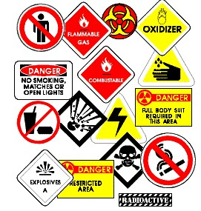
Hazard Communication (5194)

Slide 29
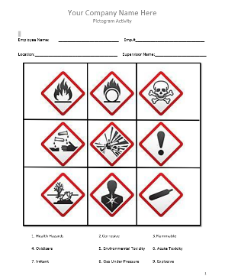
Pictogram Game

Slide 30
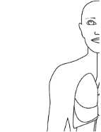


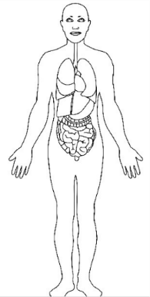
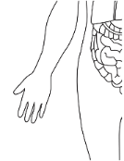
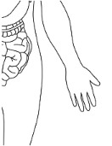


Pin the Pain

Slide 31
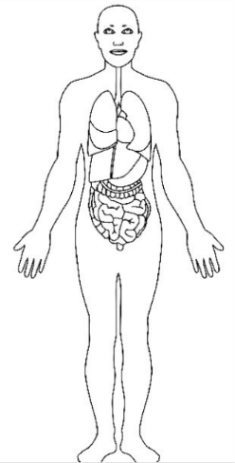
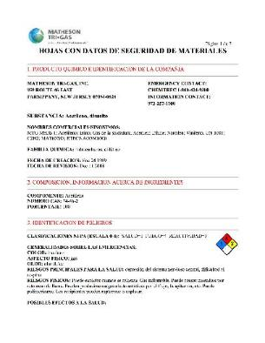
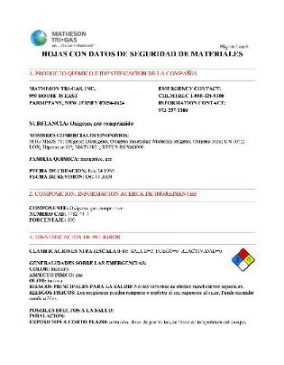
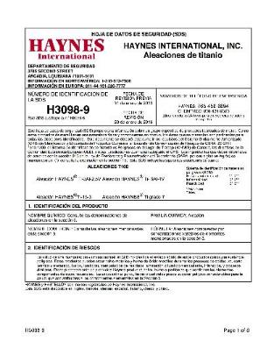
Notes:
For both of these activities – you can do one or both depending on how much time you have – make a few copies of hazard data sheets and give one to each team. You can also bring in a sample of an actual product used in the facility and the teams can work off of the information found on the label or you can have them do the extra step of finding the related hazard data sheet.
Both of these activities also use a body outline. You can just print off copies of the outline and give one to each team to work with or, preferred, print it off very large on 8 sheets of paper and hang it on the wall or lay it on the floor so the team can work together around it. If the teams can get up and move around while working on activities, it will help to keep their attention and keep them involved.
If you would like to use Pin the Pain as the class activity, tell each team that they need to use the safety data sheets (and whatever other information that is available to them) to identify the parts of the body that would be affected by excessive exposure to that particular chemical or product and then have them mark those spots on the body outline. (Example next slide)
If you would like to use Place the PPE activity instead of or in addition to the Pin the Pain activity, give the group the same basic instructions and tell them to draw the appropriate PPE on the body outline that would be necessary to protect from overexposure to the specific chemical or product. (Example next page)

Slide 32



Notes:
This is what completed Pin the Pain or Place the PPE activities look like.
We do not do this one in class but have the outlines available for demonstration.

Slide 33
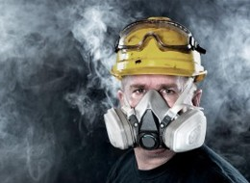
Respiratory Protection (5144)

Slide 34
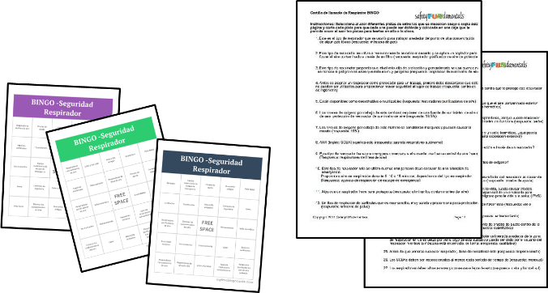
Respiratory BINGO
Notes:
Respiratory Protection BINGO – Have you all played traditional BINGO? In traditional BINGO, a random letter and number are called and you mark off that square on your BINGO sheet. Safety BINGO is just like regular BINGO except that random letter and numbers, there are words or phrases in the boxes. The words and phrases are not called out directly because this would provide limited educational value so instead, a clue describing the various words and phrases is announced and if a trainee has the answer to that clue on their SafetyBINGO card, they can cross it off.
Just like regular BINGO, the first person to get 5 across or 5 down or 5 on the diagonal should shout BINGO.
A good safety training game involves a combination of chance and skill. If the words in the boxes were simply called out, the game would be strictly chance. If the trainee was just told to answer the clue and provide the answer, that would be nothing more than a quiz (or skill). The key to effective safety training games is to have a combination of both.
Also provided is the list of clues that are read out randomly, The trainer can randomly read the clues or can cut them out separately and put into a bag and pull them out one by one and read them.

Slide 35
Training for All
Notes:
Before we talk about the activity for forklift safety, we want to say a little about using activities that are appropriate for everyone.
…. Percent of workers in the US are illiterate and … read below a …. Level so it’s really important that any training activities you use allow all trainees to participate. You also want to be careful to never embarrass someone. So, how do you do this?

Slide 36

Illiterate & don’t speak English

Slide 37
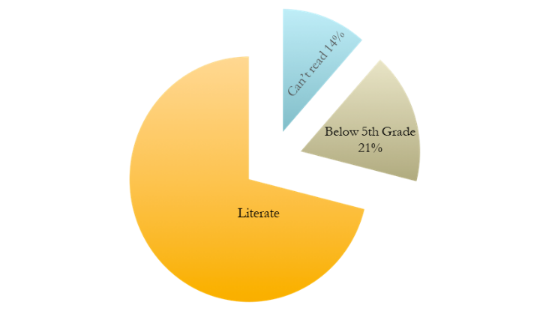
Notes:
Illiteracy
32 million US adults can’t read (14%)
21% of adults read below a 5th grade level

Slide 38

What can we do?

Slide 39

Notes:
Use image-based safety training activities whenever possible!
Additional information:
There are inherent limitations of language as a description tool
- besides our inabilities to produce accurate descriptions, there is:
- use of specialized vocabulary
- language differences
We are highly sophisticated seeing machines – first and foremost process the world visually unlike other species who use their hearing, sense of smell, etc.

Slide 40
Notes:
Remember this Safety Bingo Activity we just reviewed? This is a great activity if you are confident of the reading level of your trainees but if you are not, it could be very difficult for them to participate.

Slide 41

Notes:
No Budget? No Problem! Most of the activities we are talking about only need paper, a printer, index cards or other common office supplies.

Slide 42
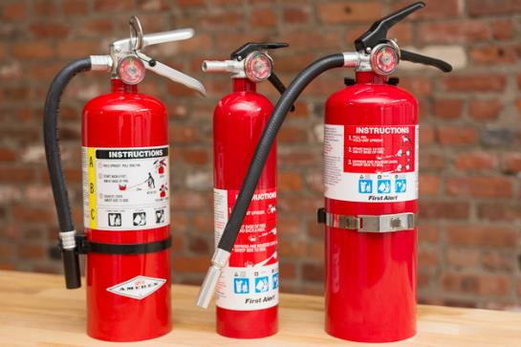
Portable Fire Extinguishers (6151)

Slide 43
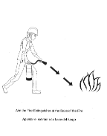
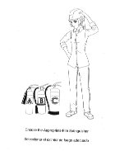
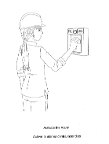
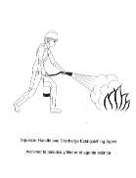
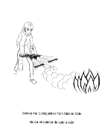
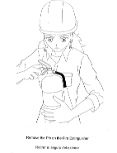
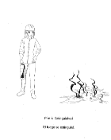
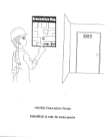
Fire Extinguisher Game

Slide 44
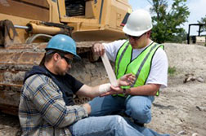
Construction: Emergency Medical Services (1512)

Slide 45
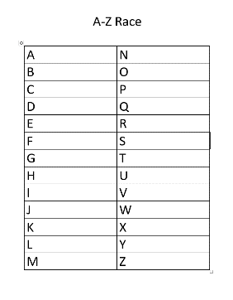
A-Z Race
Notes:
A-Z Race – this is a great team review. After putting the class into teams, ask each team to write the alphabet down the page in two columns like shown. (This can be done on regular size paper but it is easier and better for teams if a bigger sheet (like flip chart paper) is used. Tell the teams that this is a race to see which teams can fill in the space next to each letter first - the word they write next to each letter must begin with that letter and must be related to the class content. Since many people get stuck on letters like Q and X tell the teams they cam be creative when working on those lines (for example, they could spell extra as x-tra in order to get an X word. Stress that this is a race and the team that finishes fast will be declared the winner (if you can afford to give out sall prizes announce this as well).
After one team is declared the winner, go through each letter with the while class and ask what the teams filled in for each letter. This is a great way to review all of the class information and better yet, the trainees are doing the review.

Slide 46
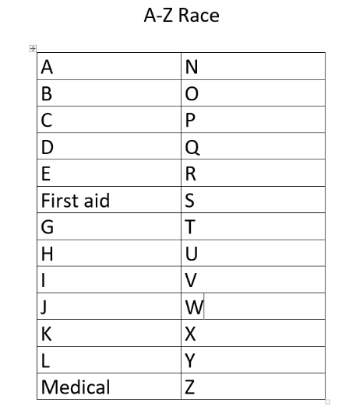

Slide 47

Emergency Eyewash/Shower (5162)

Slide 48
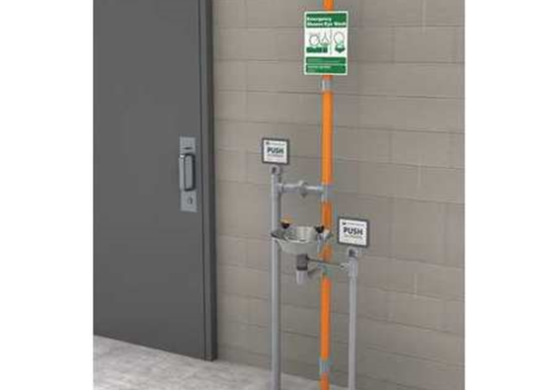
Notes:
Sign indicating location
Main valve to be on at all times
Proximity 10 seconds from chemical/corrosive materials
Dust caps in place
Function test to check water pressure
Flush lines weekly
No obstructions
No trip hazards
Shower and eyewash in line with each other to use at same time
Single activation for each
Monthly inspection documented

Slide 49
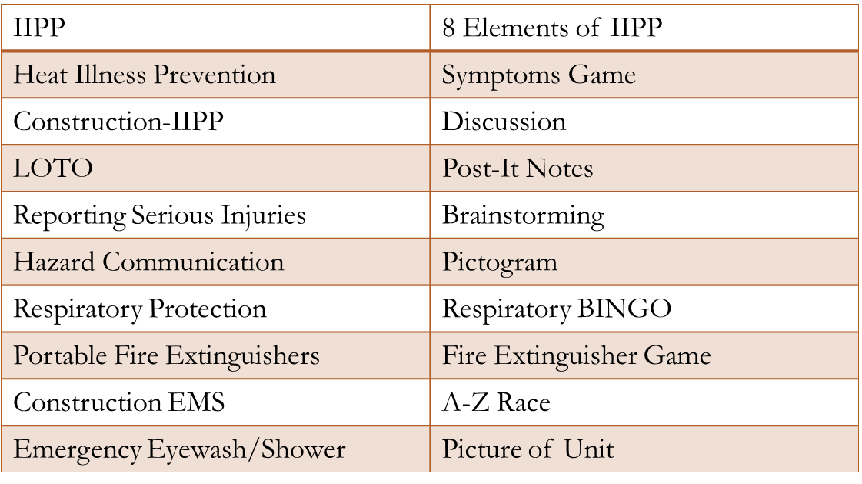
Conclusions

Slide 50


To obtain more information regarding free safety activities
Facebook.com/
SafetyFUNdamentals
FreeSafetyGames.com
Isabel.bravo@wonderful.com Linda@SafetyFUNdamentals.com
@SafetyFUN
Notes:
If you keep your completed Safety Loteria sheet and look at it later, hopefully it will serve as a memory jogger and help you remember what we covered. For more information or activities, here is our contact information. If you would like the activities we did sent to you so you can use them back at work, just leave us your card.

Slide 51

Questions

